Slide 1
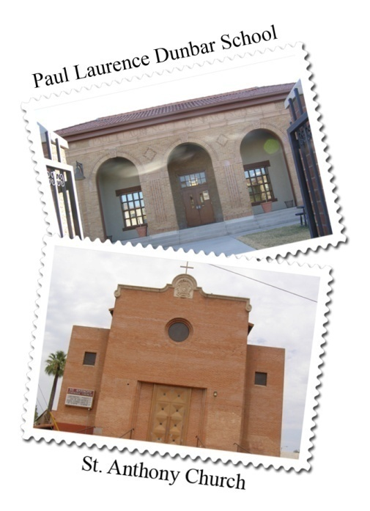

Central City South
Phoenix, Arizona
Our Community,
Our Vision,
Our Quality of Life Plan
“A community stamped with history
and carrying it with us into the future”
Revitalizing Neighborhoods,
Connecting Generations

Slide 2
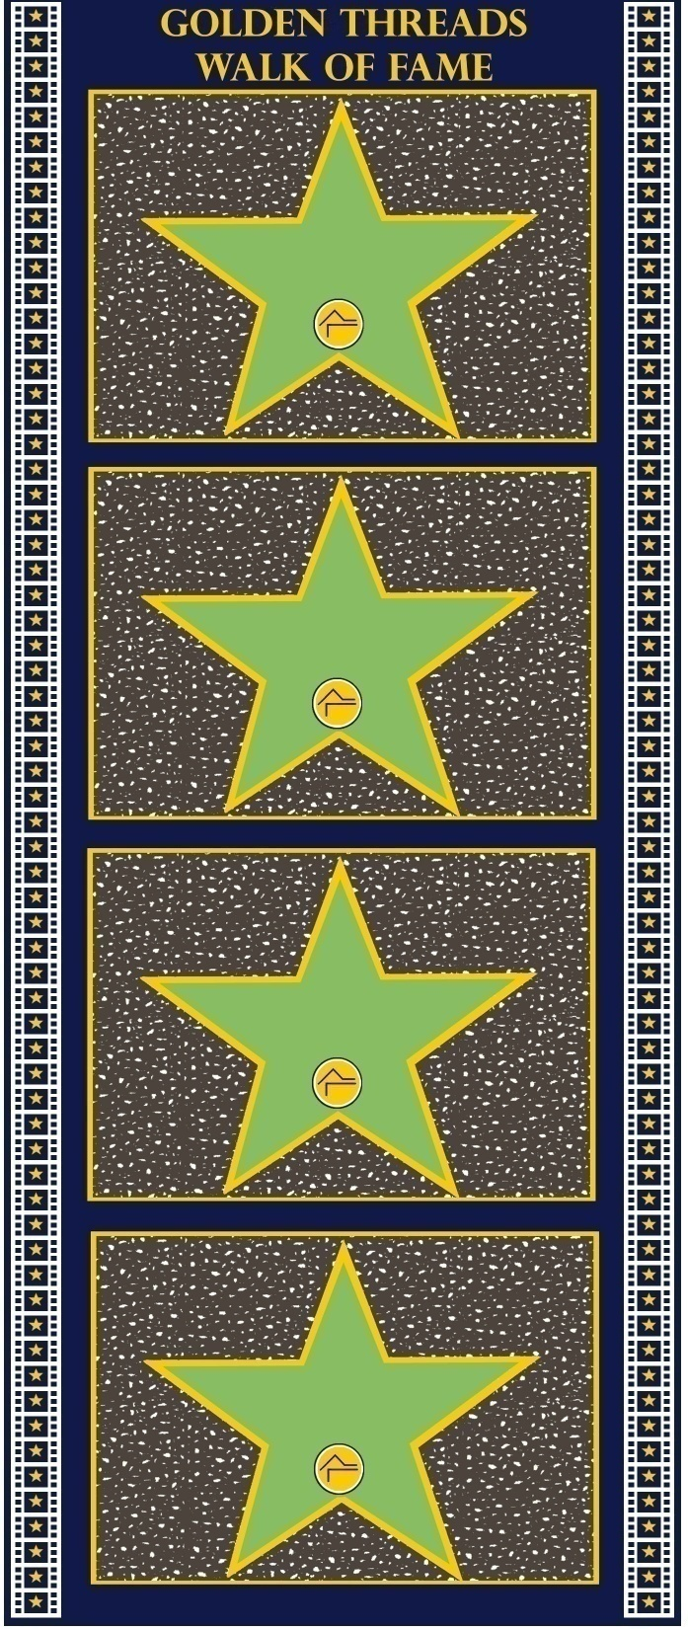
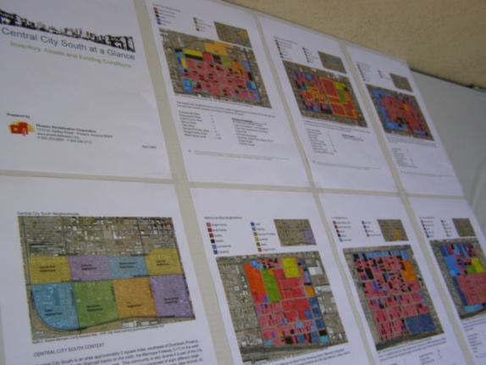
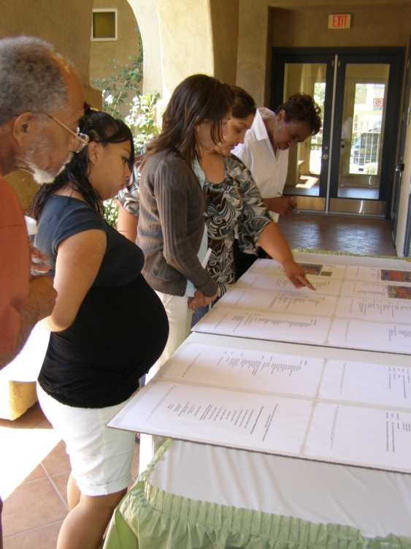
Central City South at a Glance
R. Anselmo
Resident
Surveyed all 8 neighborhoods
Recorded information about their built environment and conditions.
Some of the things we discovered….
16% is commercial
33 different churches in our community
17% is vacant
63% is residential
J. Arenas
Resident
Y. Ayon
Resident
C. Bledsoe
Resident

Slide 3
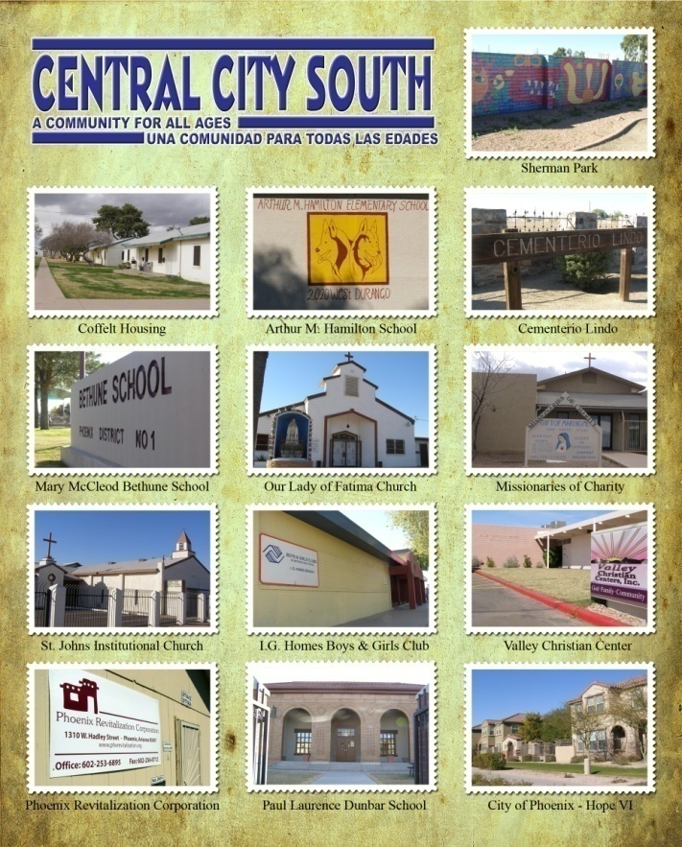
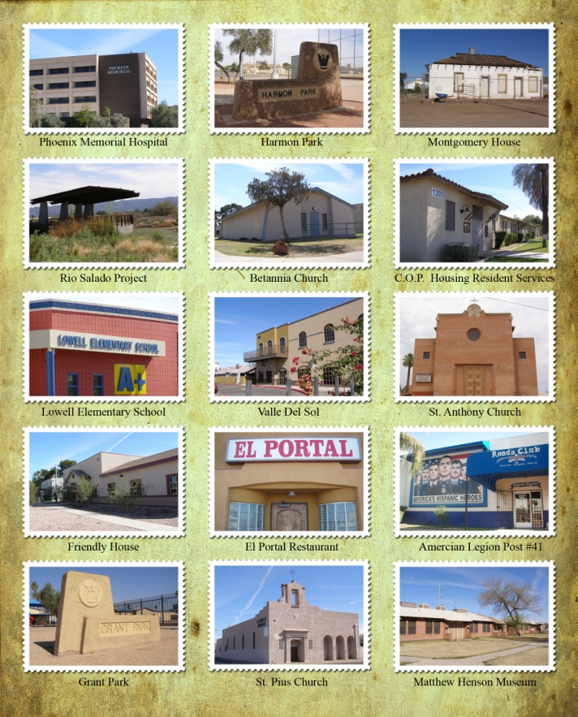
28 Points of Pride
J.E. Carson
Resident
Community Treasures…
B. Carter
Resident
M. Cleary
Resident
D. Conner
Resident

Slide 4
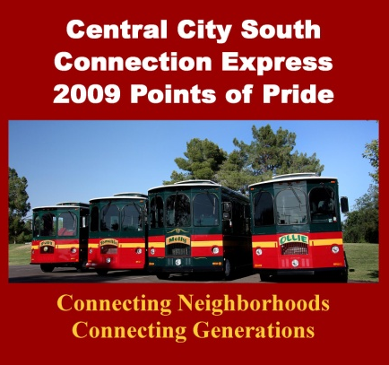
CCS Trolley Tour
I. Canez
Resident
Where our pride lies…this is our story
28 CCS landmarks
Showcasing our assets to residents, businesses and stakeholders
Discovery, realization of who’s in our community
Developing relationships and connectivity
S. Canez
Resident
S. Canez
Resident
S. Craig
Resident

Slide 5
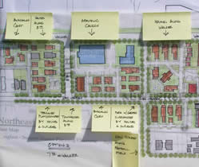
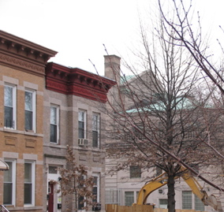
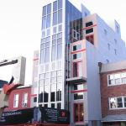
Community Power
R. Cruz
Resident
In search for POWER…
Research projects nationally
Communities telling their stories
The stories we heard….
Dudley Street Neighborhood Initiative (Boston, MA)
Sawmill Community Land Trust Revitalization Project (Albuquerque, NM)
Little Village Capitol of the Mexican Midwest (Chicago, IL)
Blue Hills and Douglas-Summer Communities (Kansas City, KS/MO)
Some Place like Home: Gentrification of Downtown Brooklyn/Fort Greene (NY)
E. Delgado
Resident
D. Donet
Resident
T. Eliserio
Resident

Slide 6
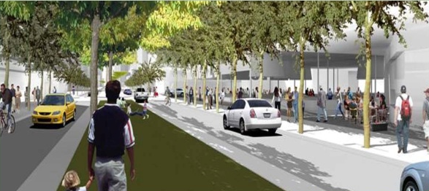
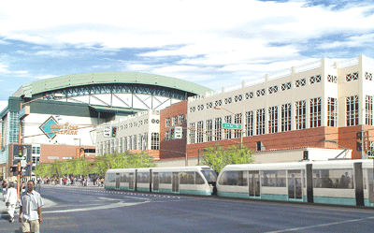
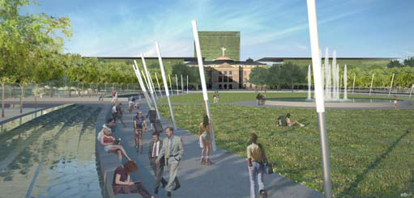
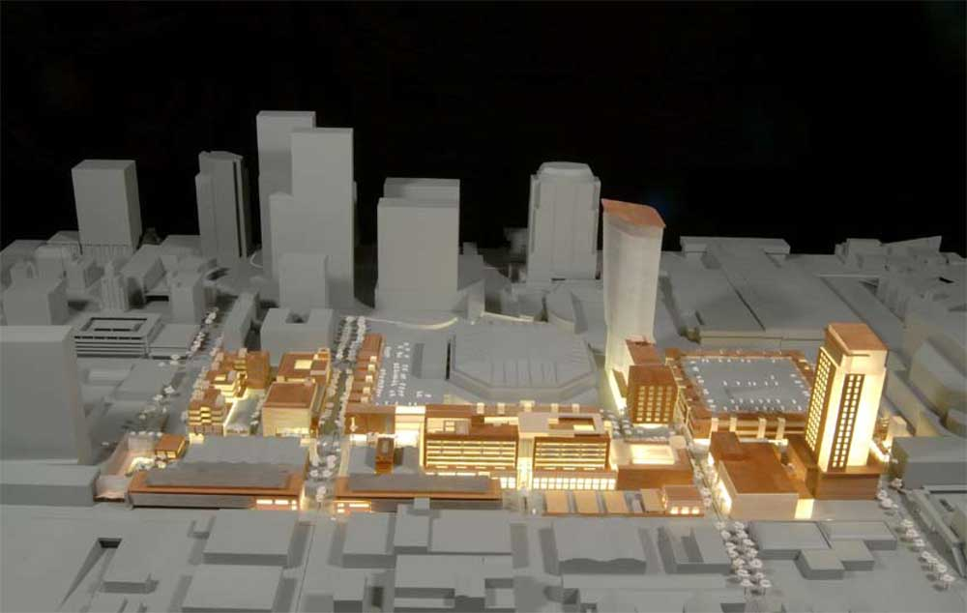
The Big Picture
G. Favela
Resident
Current developments surrounding CCS…
Form Based Codes
Transportation
Capitol Mall
Jackson Street Entertainment District
CityScape
Rio Salado
WHATS NEXT FOR US?....
M. Garcia
Resident
L. Hamilton
Resident
F. Hernandez
Resident

Slide 7
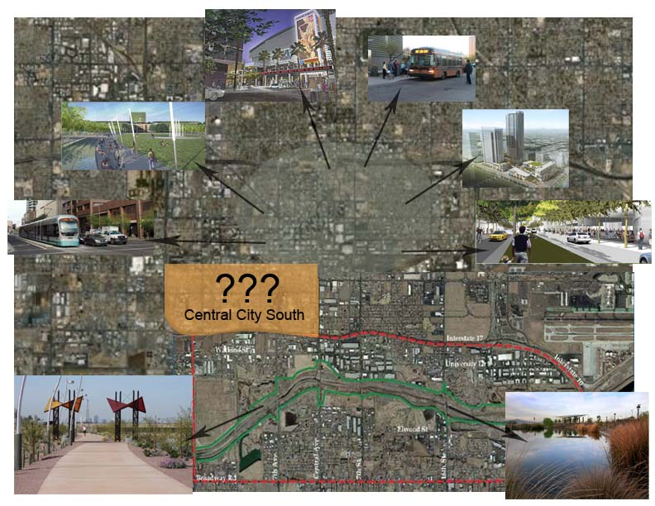
Weighing the information…
J. Hernandez
Resident
How will these developments affect our community?
What opportunities come with this change?
How do we guide and contribute to change that is coming?
W. Hernandez
Resident
M. Torres
Resident
L. Hickman
Resident

Slide 8
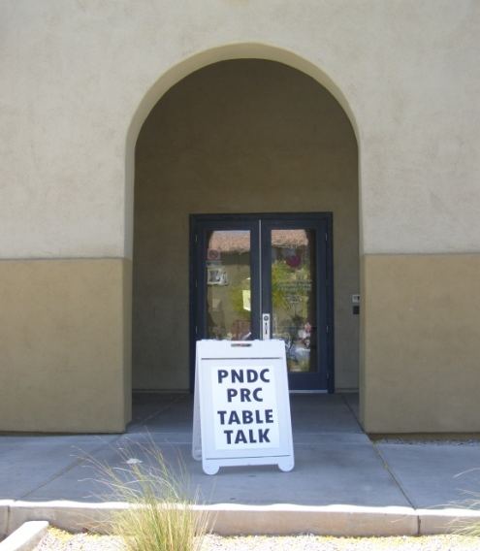
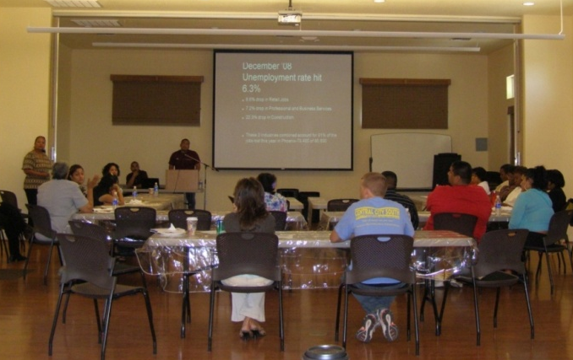
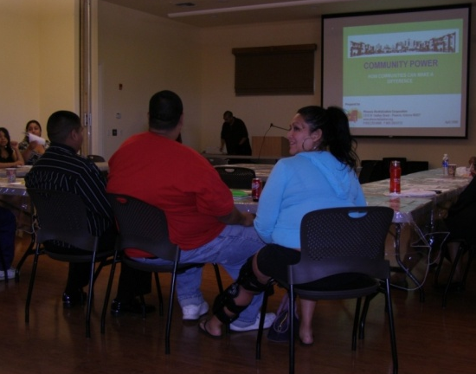
Let the conversations begin…
J. Holm
Resident
Originally planned as two meetings: Table Talk and Table Talk and Some
POWER of the community towards the end of the 1st two meetings was still growing…
Resulted in four meetings total
D. Jendrick
Resident
K. Kimya
Resident
R. Lopez
Resident

Slide 9
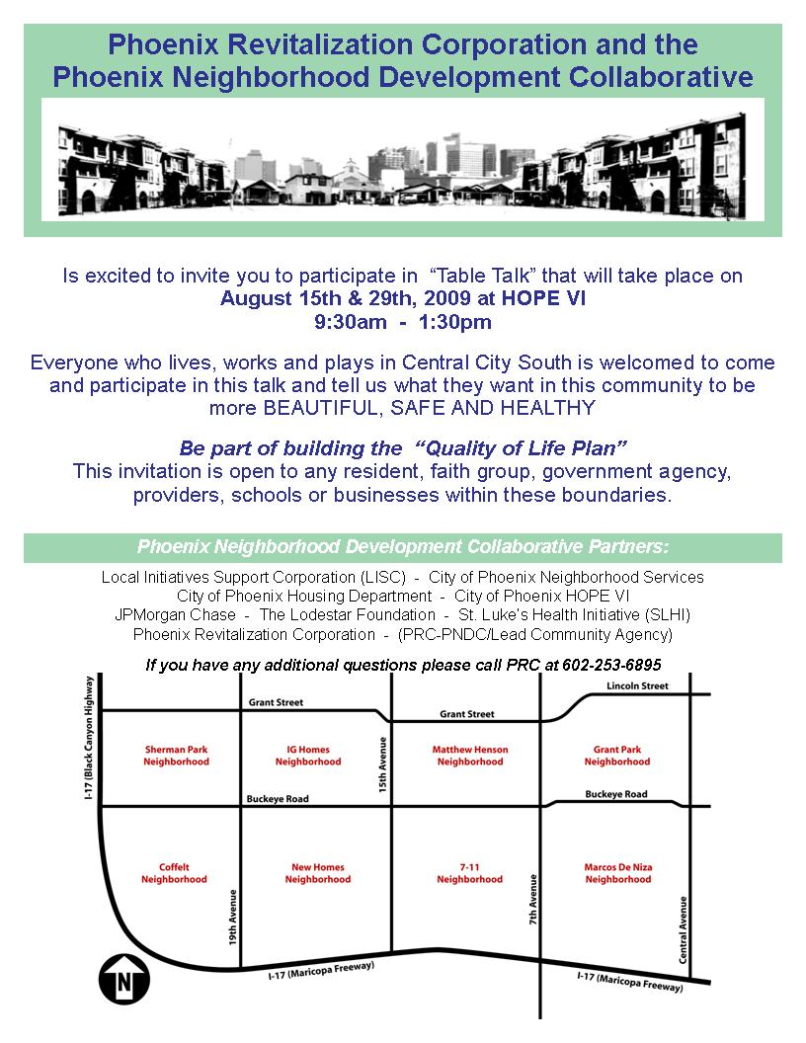
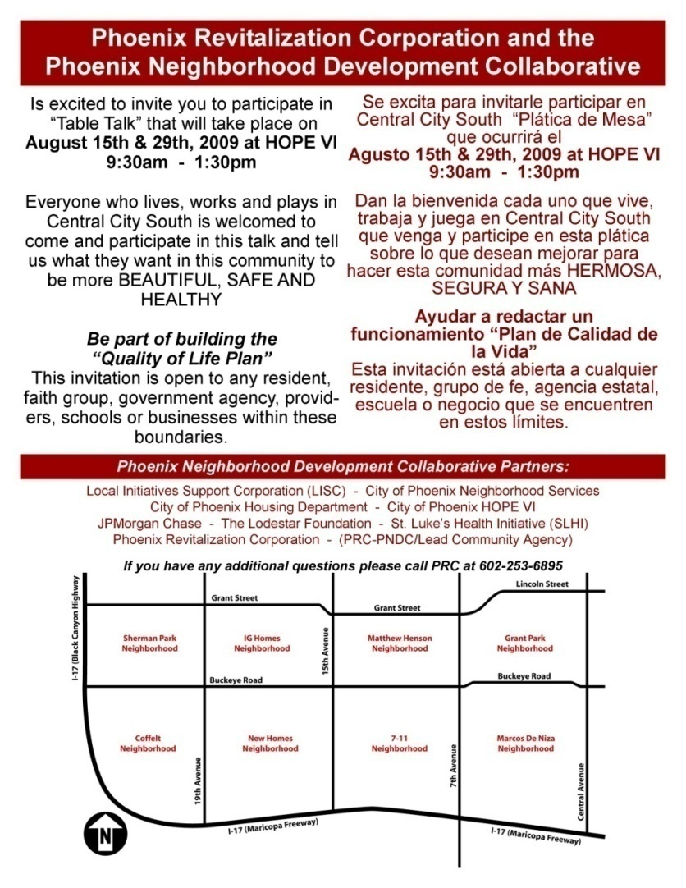
D. Manella
Resident
B. Martin
Resident
J. Mendez
Resident
A. Mendez
Resident

Slide 10
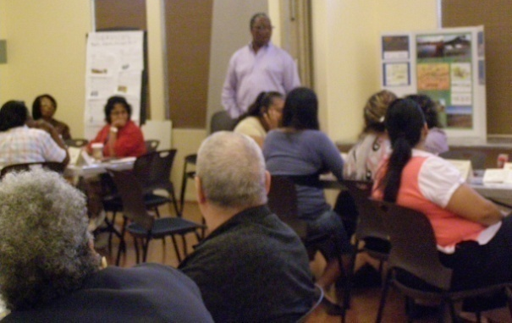
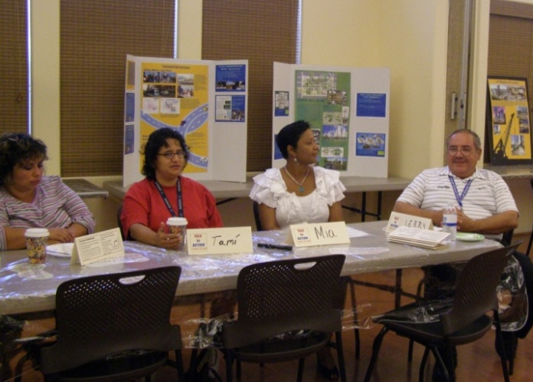
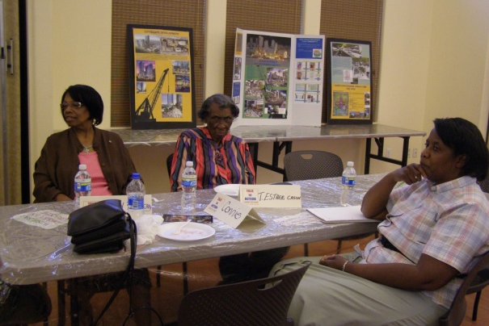
04.25.09
L. Moreno
Resident
Table Talk-Community Power
Food for the Soul- Getting information
J. Muhammad
Resident
M.S. Ontiverez
Resident
M. Ontiverez
Resident

Slide 11
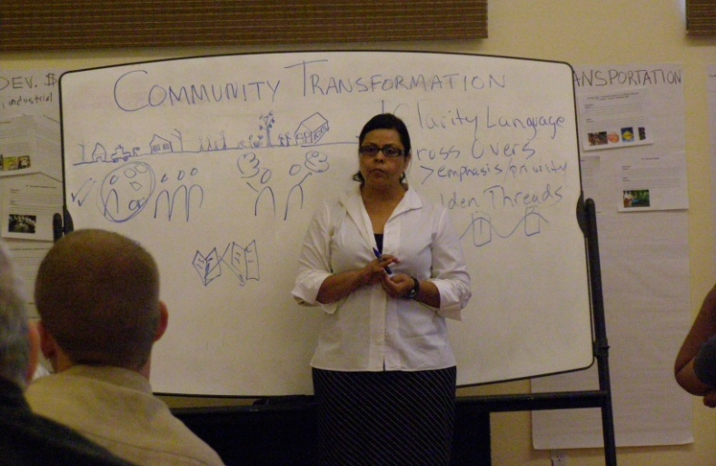
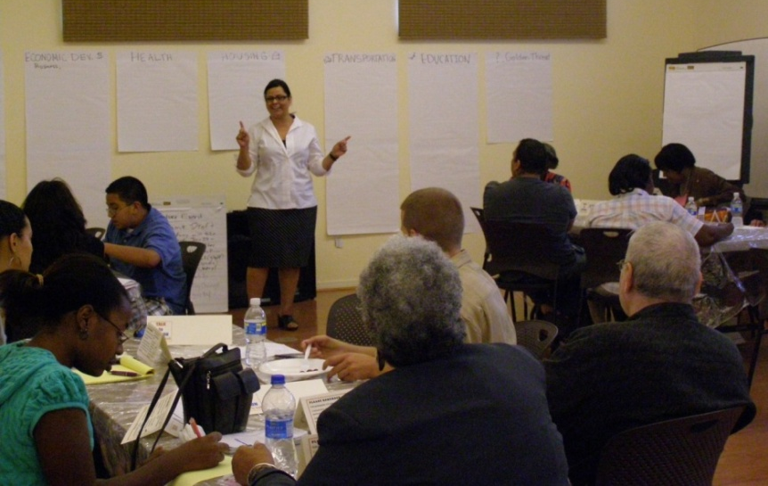
05.16.09
K. Pickett
Resident
Table Talk and Some - The Big Picture
New Age Coming…Preparing for and Guiding Change
R. Pinkins
Resident
L. Preston
Resident
N. Qaasim
Resident

Slide 12
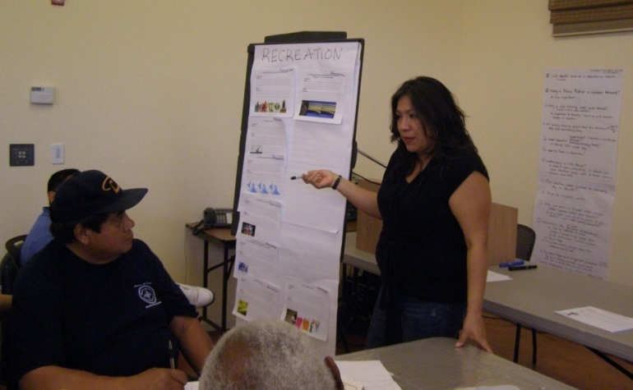
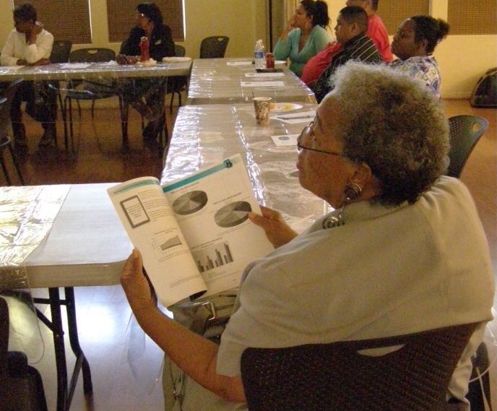
08.15.09
H. Torres
Resident
Table Talk and Some
Dream Big! Wish Big! Make it Happen!
V. Turner
Resident
S. Toles
Resident
Z. Turner
Resident

Slide 13
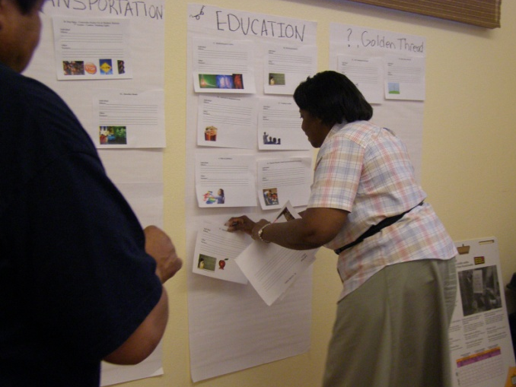
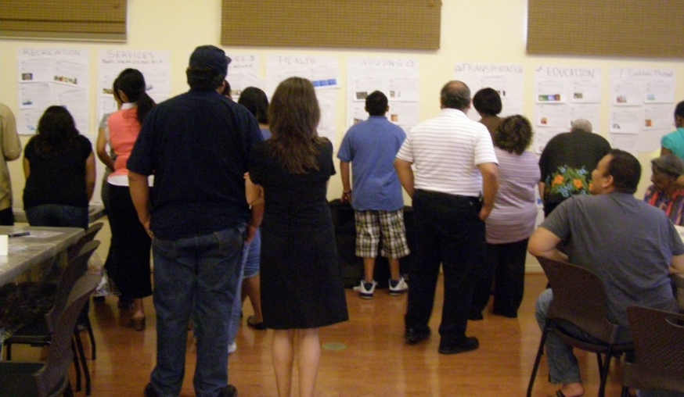
08.29.09
D. Washington
Resident
Table Talk and Some
The Work, the Vision, the Plan!
L. Williams
Resident
S. Wane
Resident
c. Widmer
Resident

Slide 14
What Happened?...
Ziryah
Resident
New inspiration , connectivity , unity and inclusion between residents of all ages and neighborhoods.
Community Empowerment
A living, breathing, changing Quality of Life Resident Driven Plan that welcomes new residents and partners through the process.
Increased civic engagement to support the Quality of Life Plan work.
A commitment to preserve the stories and history of Central City South.
Quarterly Table Talk Gatherings for the next 5 years.
Central City South has become a point of interest for new partners.
V. Roman
Resident
A. Romo
Resident
M. Rosales
Resident

Slide 15







C. Rondan
Resident
R. Ruiz
Resident
Thank you!
And a special thanks to all the CCS residents and stakeholders who participated to make this possible
M. Salazar
Resident
J. Salazar
Resident
Neighborhood Services

Slide 16
What next?....
B. Salazar
Resident
We are looking for partners to assist with the strategies
We are looking for funders to support the work to achieve our strategies
S. Salazar
Resident
Where can you get more information?...
G. Salinas
Resident
The QLP is available on the PRC website www.phxrevitalization.org
And now….
M. Rondan
Resident

Slide 17

Name
Role
Name
Role
Presenting
The CCS Quality of Life Plan Strategies
Name
Role
Name
Role
Notes:
17

Slide 18
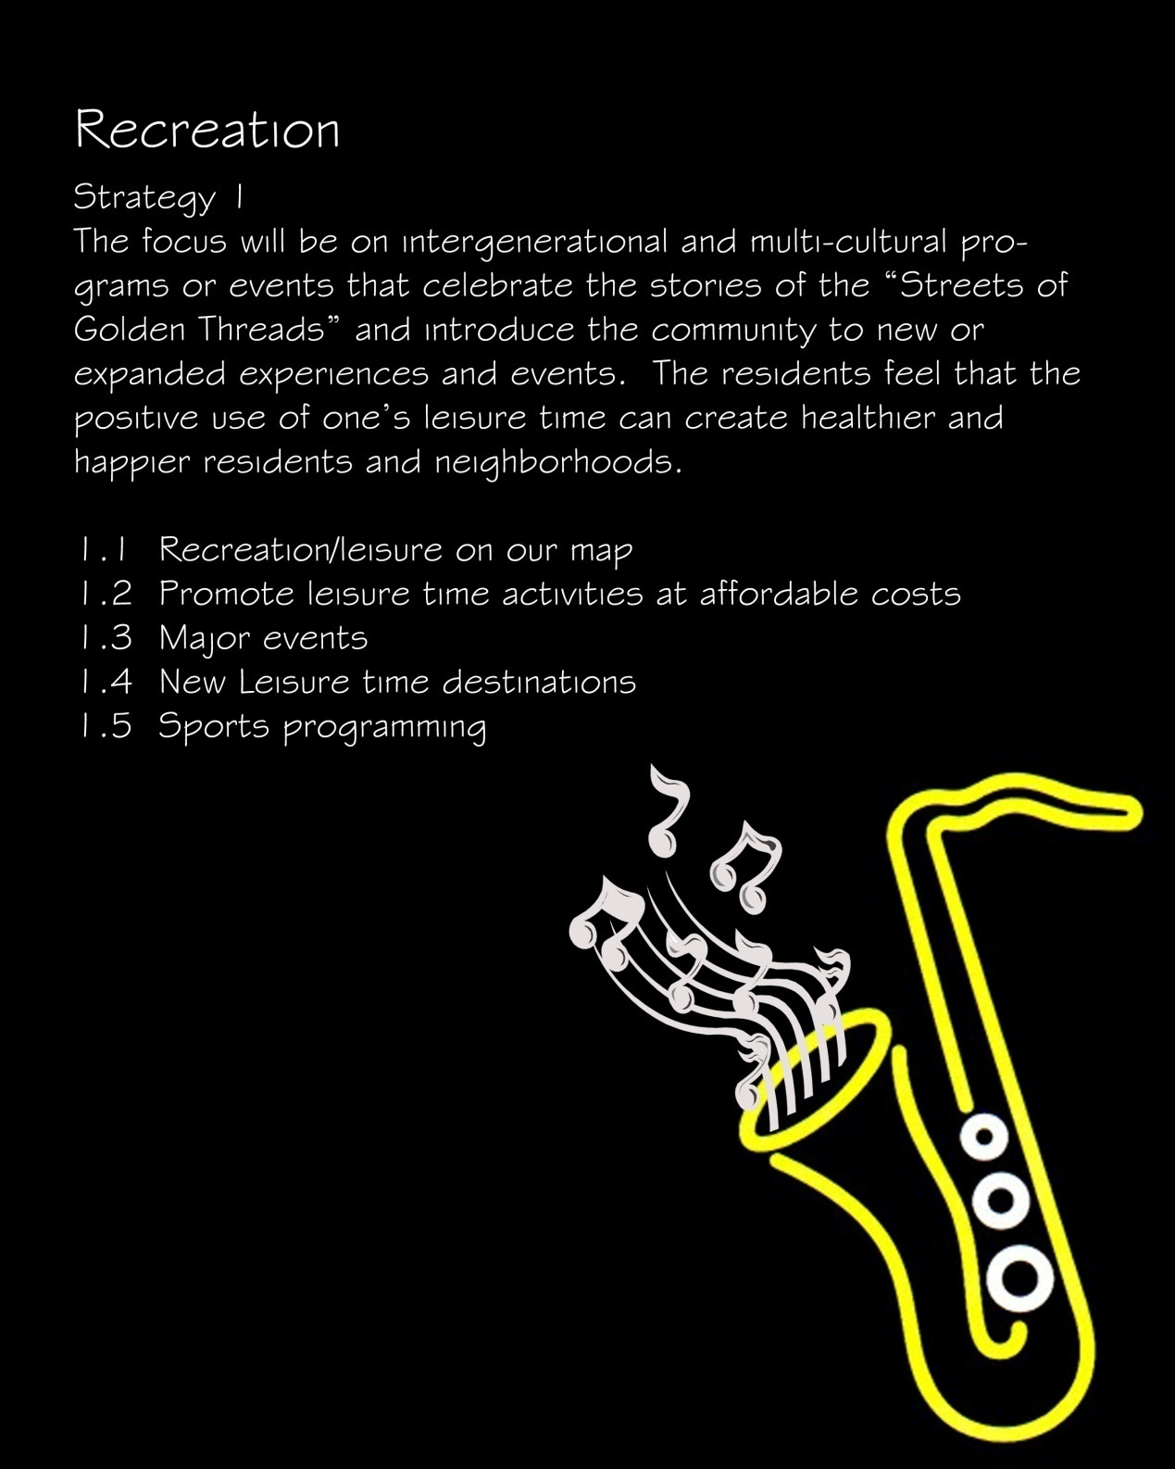
Recreation
Strategy 1
The focus will be on intergenerational and multi-cultural programs or events that celebrate the stories of the “Streets of Golden Threads” and introduce the community to new or expanded experiences and events. The residents feel that the positive use of one’s leisure time can create healthier and happier residents and neighborhoods.
1.1 Recreation/Leisure on our map
1.2 Promote leisure time activities at affordable costs
1.3 Major events
1.4 New Leisure time destinations
1.5 Sports programming
R. Solano
Resident
K. Hymes
Athletes of Awareness
M. Albarron
El Quinto Sol
K. Records
ASU

Slide 19
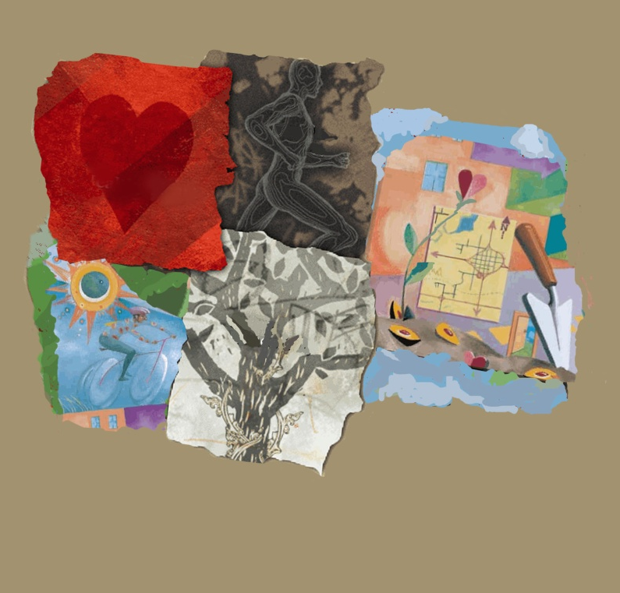
Health
Strategy 2
The community has stated that there is a need to increase awareness and education on healthy living. Additionally, they identified facilities or services that are essential to meeting this need.
2.1 Affordable Health care
2.2 Healthy Family Service Center
2.3 Health Education
2.4 Fitness
2.5 Community Gardens
H. King
Angels of Jerusalem
E. Boyd
City of Phoenix / Recreation Dept.
A. Nagel
ASU / College of Nursing
S. Harlan
ASU / Evolution and Social Change

Slide 20
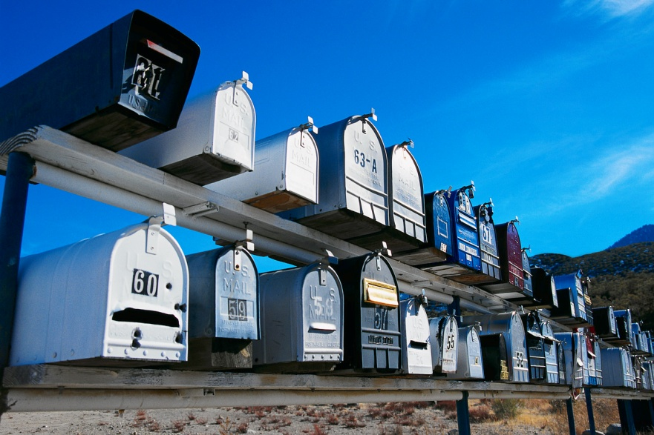
Services
Strategy 3
While residents feel that Central City South is service rich, they feel that there is a need to promote and develop a stronger relationship between service providers and the community. They also expressed the expansion and/or development of particular services listed below and methods to inform the community.
3.1 Service areas
3.2 Community Promotions/Media Plan
K Cea
Arizona Public Service
C. Termini
JPMorgan Chase
F. Taylor
Southwest Prostate Cancer Foundation
R. Ruiz
Our Lady of Fatima Church

Slide 21

Individual Development
Strategy 4
The community categorized this in three areas: Employment, Education and Training. By addressing these areas it is assumed that the unemployment rate will decrease and that the family household income will increase.
4.1 Employment/Jobs
4.2 Education
4.3 Trainings and Workshops
Officer M. Ballentine
City of Phoenix Police Dept.
S. Brittle
Environmental Justice
Non-Profit
R. Castro
Valley Christian Center
J. Larios
CASE

Slide 22
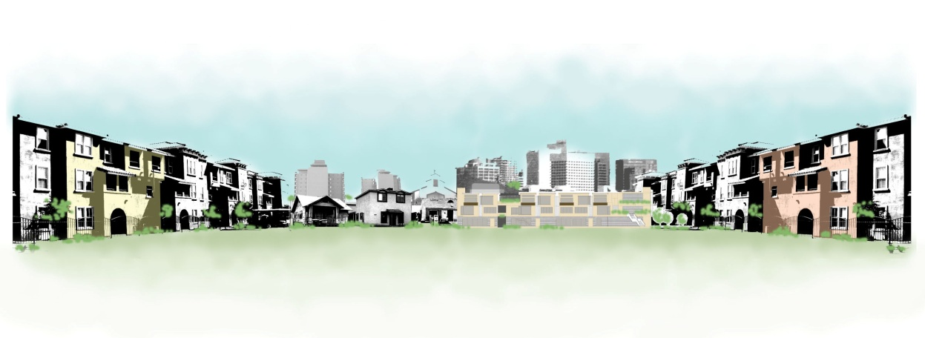
Housing
Strategy 5
The community recognized two areas with regards to the housing stock in Central City South. First, how to improve the condition of the existing homes and second the addition of new housing stock on vacant properties. It was the vision of the group that homes in Central City South will be occupied.
5.1 Lead-free Housing
5.2 Livable existing Housing
5.3 Housing on Vacant Lands
5.4 Accountability for landlords
S. Murphy
Girl Scouts of America
S. Tarboro
Southwest Fair Housing
J. Newman
City of Phoenix/ H.O.P.E. VI Project
C. Malone
City of Phoenix/ H.O.P.E. VI Project

Slide 23
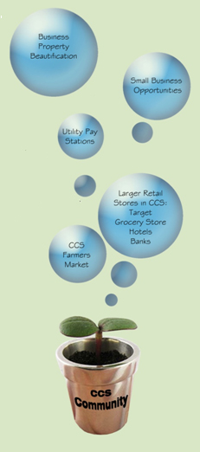
Economic Development
Strategy 6
The Central City South community realizes that change is coming. Their vision is that CCS has within it boundaries all the amenities and opportunities that can be found in newer and younger neighborhoods. These amenities/businesses will bring with them services, resources, retail and employment opportunities.
6.1 Promote CCS as a viable location for reputable larger retail and other businesses
6.2 Create a Farmer’s Market in Central City South
6.3 Create local pay stations for utilities
6.4 Create renaissance zones that promote small business opportunities
6.5 Business property beautification
6.6 Strengthen a business network
6.7 Increase business employment opportunities
M. Martin
ADEQ
T. Fields
City of Phoenix/ Neighborhood Services
M. Lamm
City of Phoenix/ Recreation Dept.
B. Russell
City of Phoenix

Slide 24
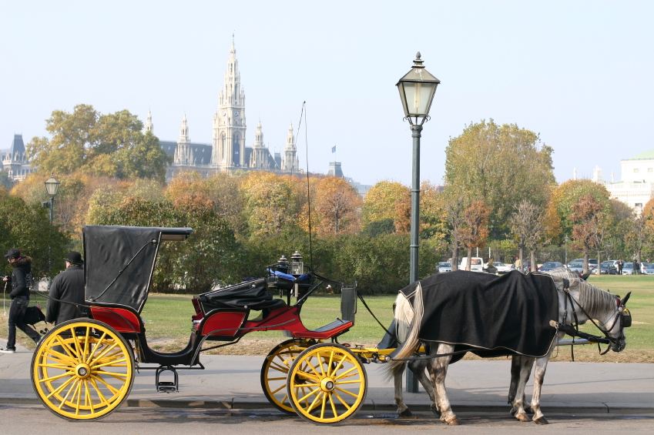
Transportation
Strategy 7
Transportation is considered critical link between the community to services and opportunity.
7.1 Bus Stops
7.2 Pedestrian walking lights
7.3 Public Transportation
7.4 Surface Streets
7.5 Railroad Tracks
J. Brown
City of Phoenix
M. Cason
Discover Me Substance Abuse Coaching Program
J. Castro
St. Vincent de Paul
N. Bryant
Ctr. For African Ameri. Health AZ

Slide 25
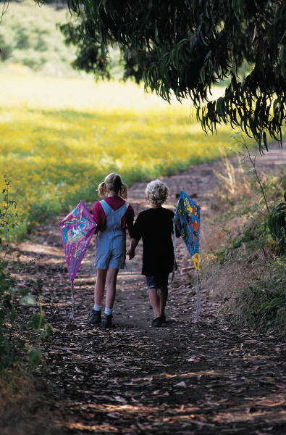
Golden Threads
Strategy 8
Golden threads include three areas: Pride, Community Safety and Beautification. The residents stated that if these three areas are addressed the result will be residents smiling and vocalizing their happiness in their community. The “Neighbor to Neighbor” feelings of helping each other will sustain all the work accomplished in the Quality of Life Plan.
8.1 Pride
8.2 Community Safety
8.3 Beautification
8.4 Neighbor to Neighbor
A. Perez
ASU
College of Nursing
M. Garcia
I.G. Homes Boys and Girls Club
L. Enriquez
Friendly House, Inc.
T. Hardy
Stakeholder

